Slide 1
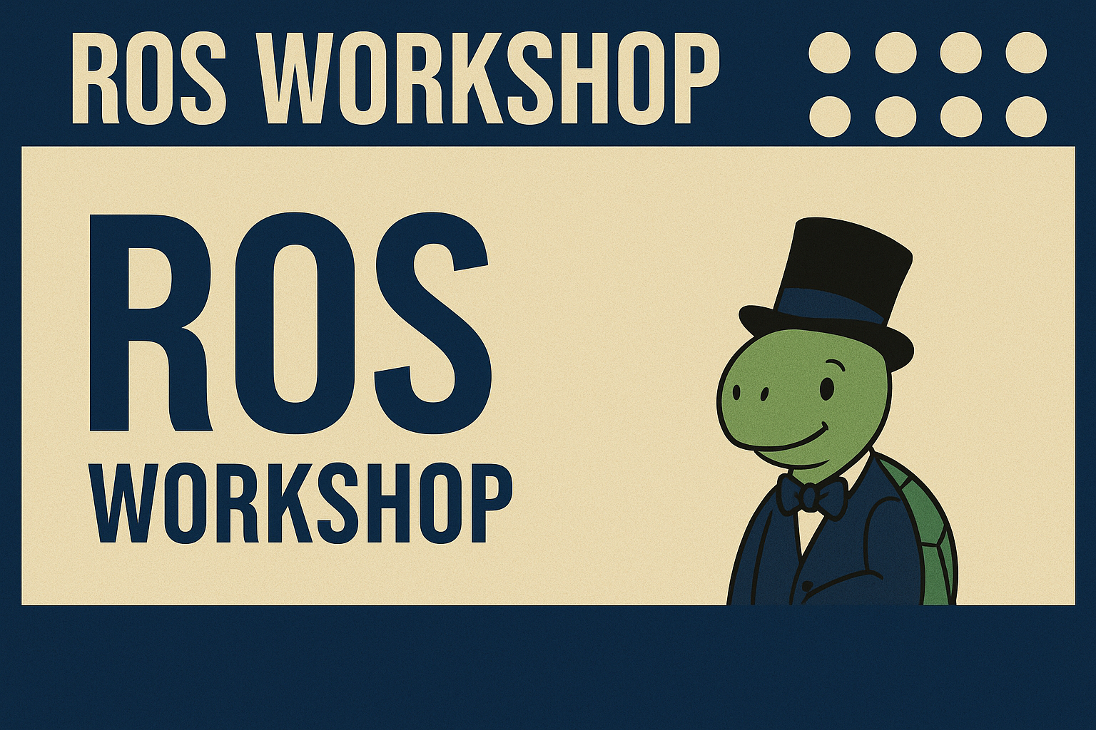

06/05/25 - B15 LM4

Slide 2
ONBOARDING LESSON

Slide 3
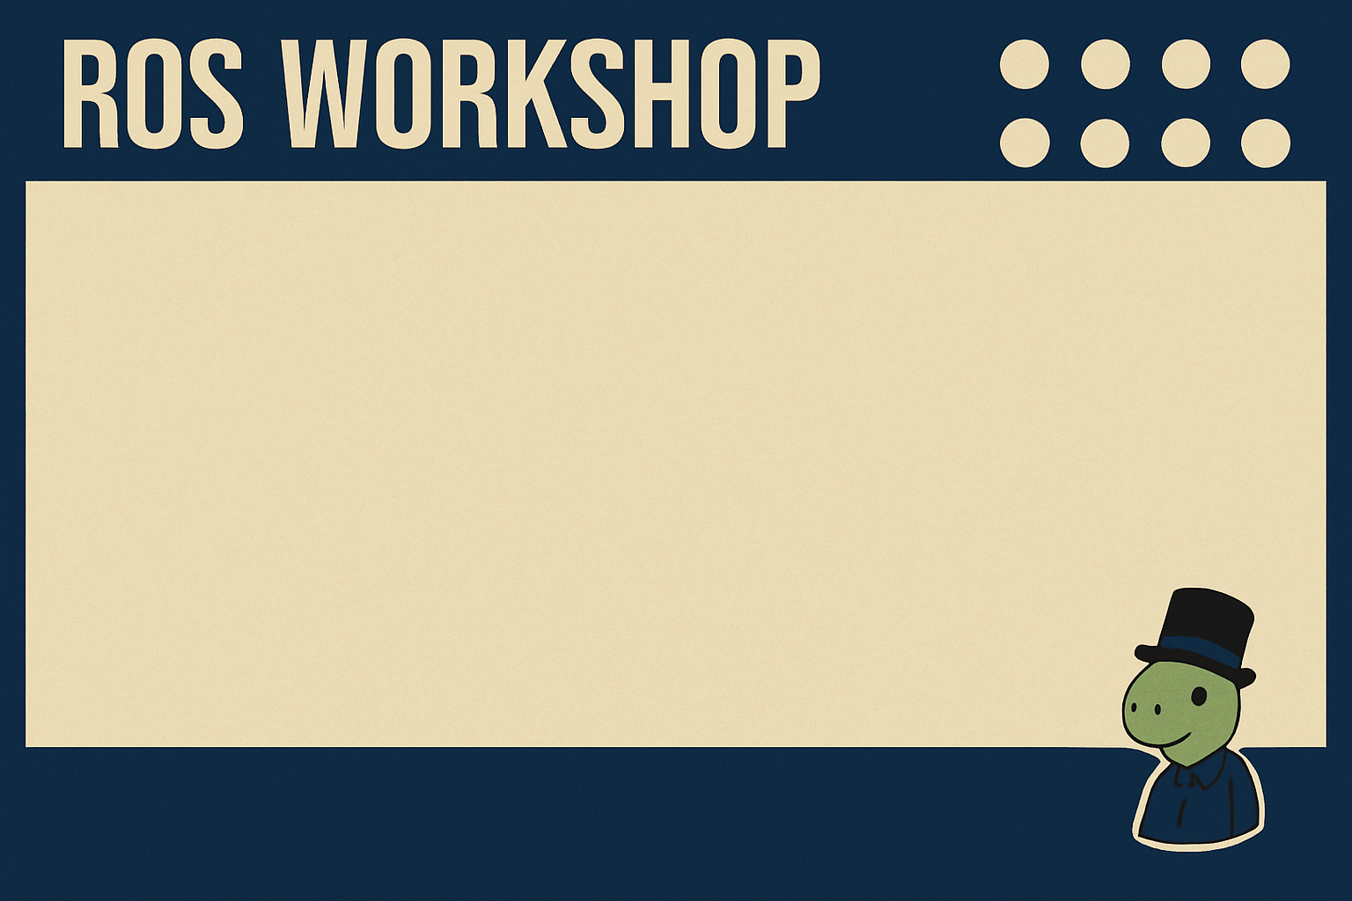
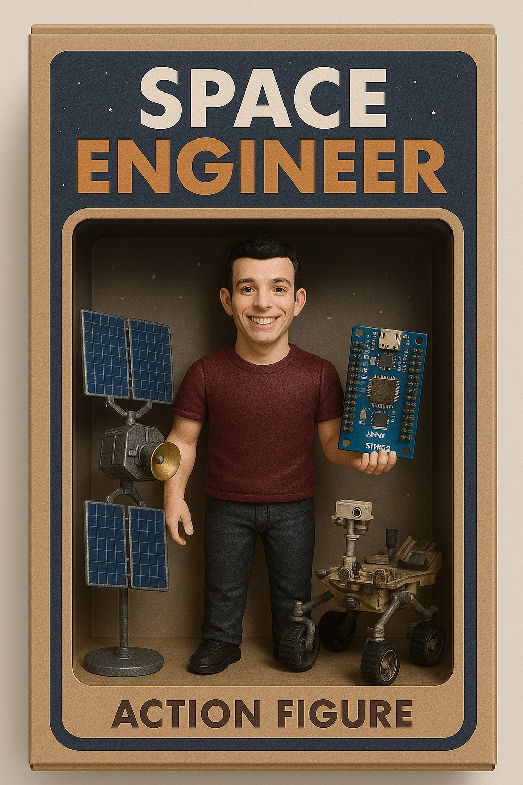

HELLO!
Federico De Donatis
Luca Attorrese

Slide 4


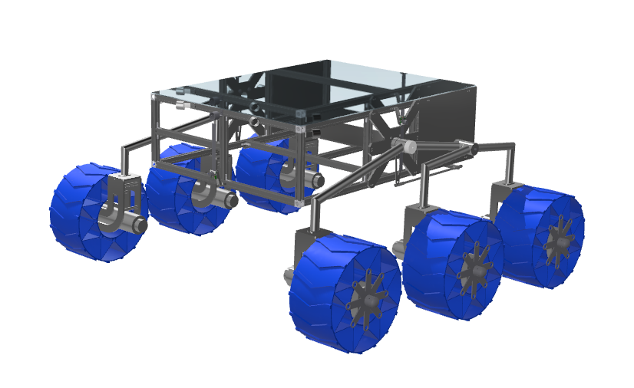

[R]overTech
Student association
Build an autonomous rover
With an autonomous arm
With an autonomous drone
For the European Rover Challenge (ERC)
Krakow

Slide 5
Scheduling
6th May - B15 LM4 - Introduction to the software ROS and first examples
12th May - B15 LM4 - Introduction to the GNSS module and how to use GNSS data inside ROS
16th May - B15 LM4 - Introduction to the navigation
problem and examples - B15 LM4

Slide 6
What is ROS?
The Robot Operating System (ROS) is a set of software libraries and tools that help you build robot applications. From drivers to state-of-the-art algorithms, and with powerful developer tools, ROS has what you need for your next robotics project.
And it's all open source.

Slide 7
What is ROS? - MW
ROS is a MIDDLEWARE:
Middleware is software that acts like a bridge between different parts of a system — especially between the low-level hardware and the high-level applications.

Slide 8
What is ROS?-Example
Example of Middleware (ROS) in a Robot:
Camera captures images.
Obstacle Detector Node processes images.
Motor Controller Node moves or stops wheels.
Middleware (ROS) lets these nodes communicate without being directly connected — like a message bus between them.

Slide 9
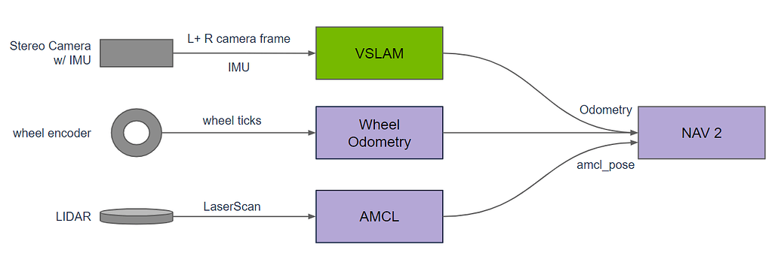

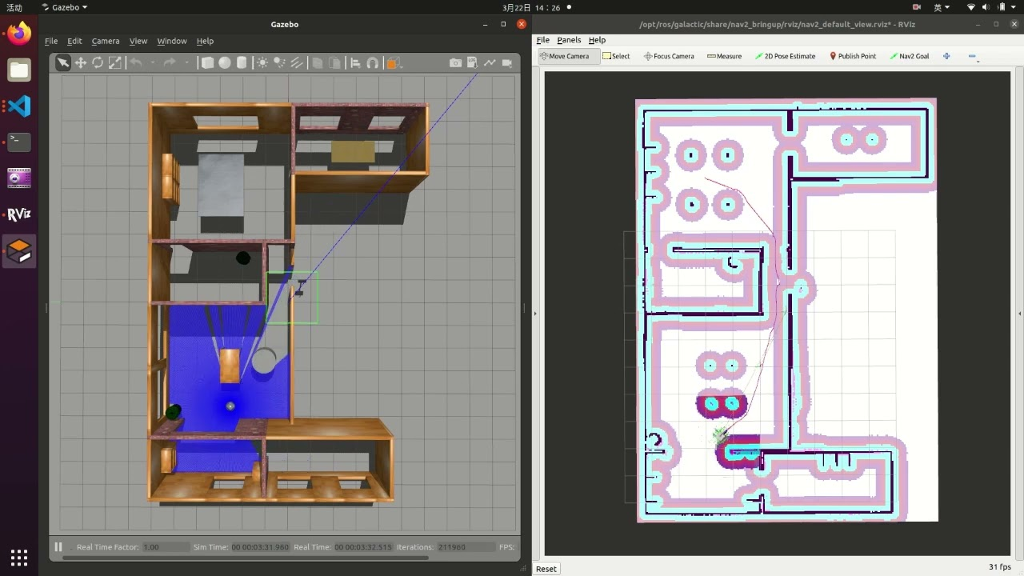
What is ROS?-NAV2

Slide 10

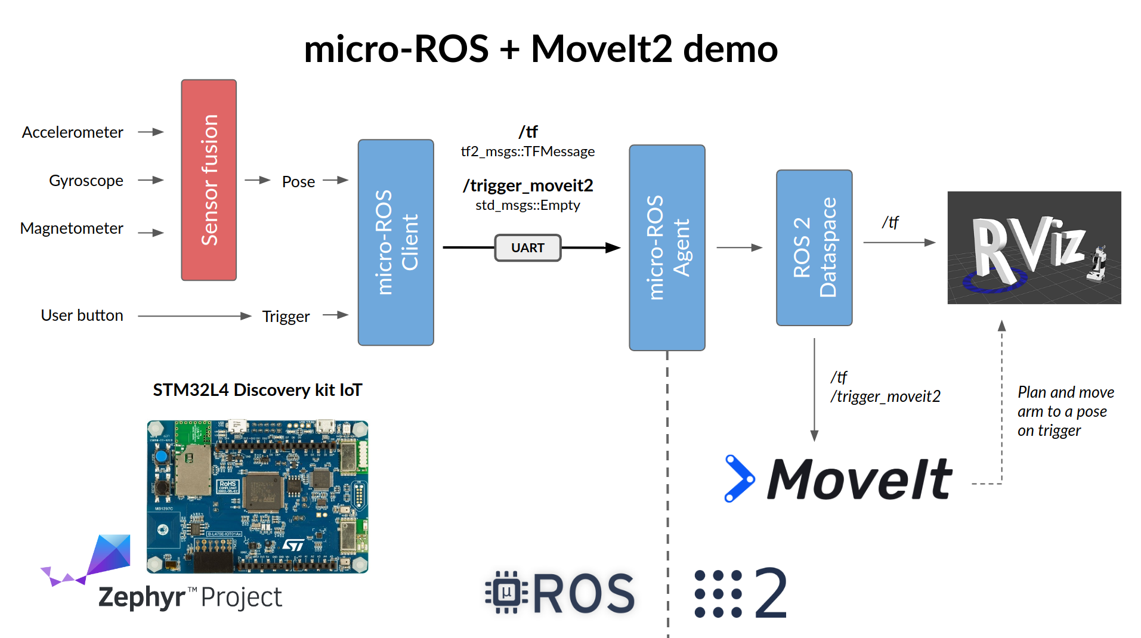
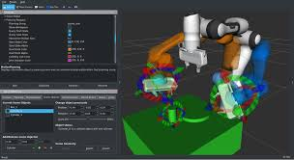
What is ROS?-MoveIt

Slide 11
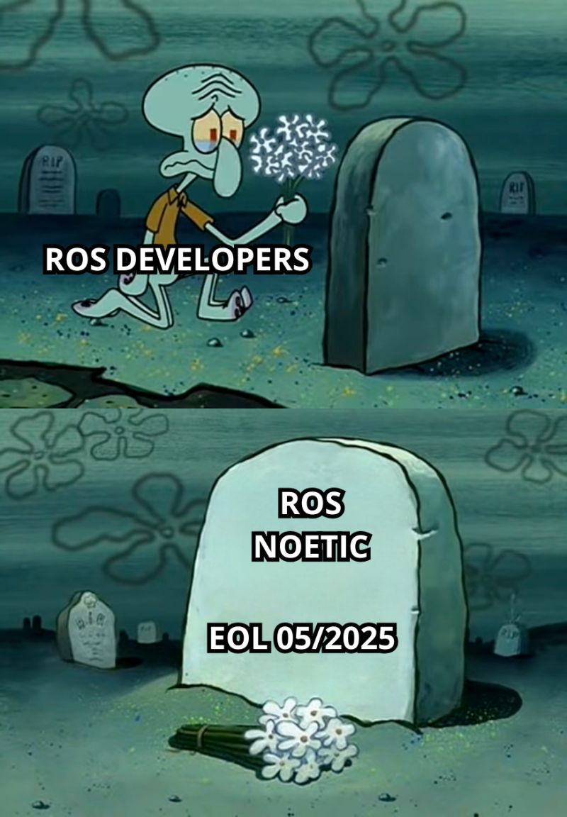
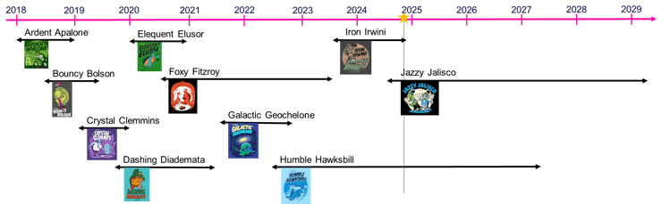

ROS(1) vs ROS2

Slide 12
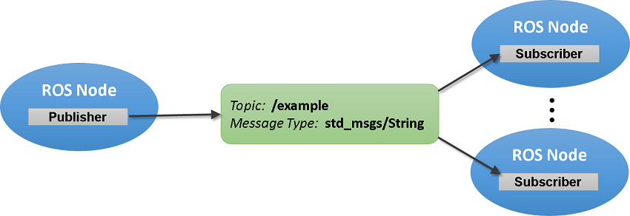
ROS: Nomenclature
- Node: a program (read a sensor, sensor fusion, control law…).
- Topic: bridge where different nodes can share data (continuously).
- Service: (one time) synchronous communication mechanism (ask for data or send interrupt).
- Action: is like a service, but for longer tasks that take time and can give feedback while running (follow a path with encoder feedback).

Slide 13

Installation (Windows)
Windows Subsystem for Linux: allows to simulate a Linux environment, with command-line tools and GUI
Uses Ubuntu 22.04
The compatible ros2 distribution is Humble Hawksbill

Slide 14
Installation (Windows)
Open Windows Powershell
wsl --install -d Ubuntu-22.04
First time may require username and password (p.s. Password don’t appears while typing!)

Slide 15
Installation (Windows)
If wsl is already installed it will open (we noted that for someone instead a new installation starts. To avoid this problem, use the command wsl to open the linux environment)

Slide 16



Installation
https://docs.ros.org/en/humble/Installation/Ubuntu-Install-Debs.html
https://docs.ros.org/en/humble/Installation/Alternatives/macOS-Development-Setup.html

Slide 17
Ex1.1: Turtlebot
[Win/Ub: tmux]
What is tmux? Is a tool for terminals management; tmux = terminal multiplexer
In the next slide you can find a cheatsheet with the necessary commands

Slide 18
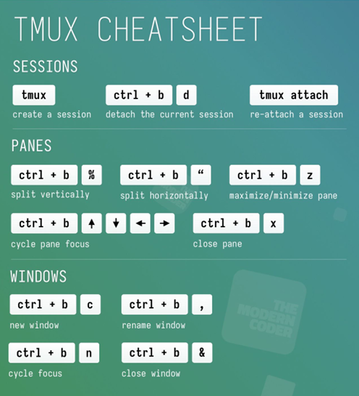
Ex1.1: Turtlebot

Slide 19
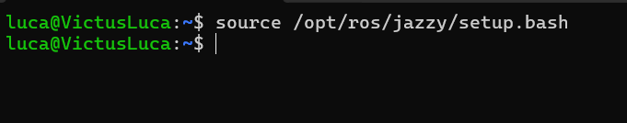
Ex1.1: Turtlebot
[Win/Ub: source /opt/ros/humble/setup.bash]
[MacOs: . ~/ros2_humble/install/setup.zsh]
You should have already sourced the environment from the last step of the installation phase. If it’s working fine, this is what you should see:
humble

Slide 20
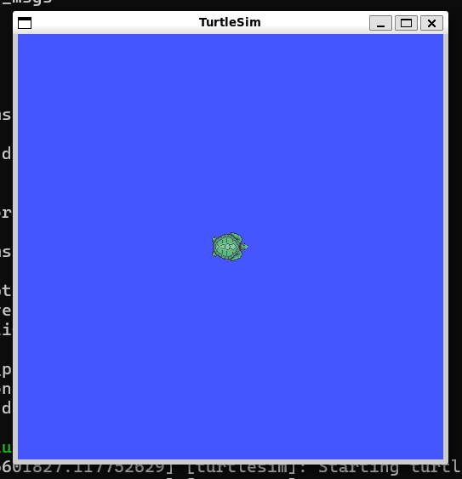
Ex1.1: Turtlebot
Now we’re ready to run our first example!
ros2 run turtlesim turtlesim_node

Slide 21
Ex1.1: Turtlebot
To control the turtle, we need to open a new terminal (Win/Ub: Ctrl+b then %) and then run:
ros2 run turtlesim turtle_teleop_key
Using your arrow key, you can now control the turtle!

Slide 22
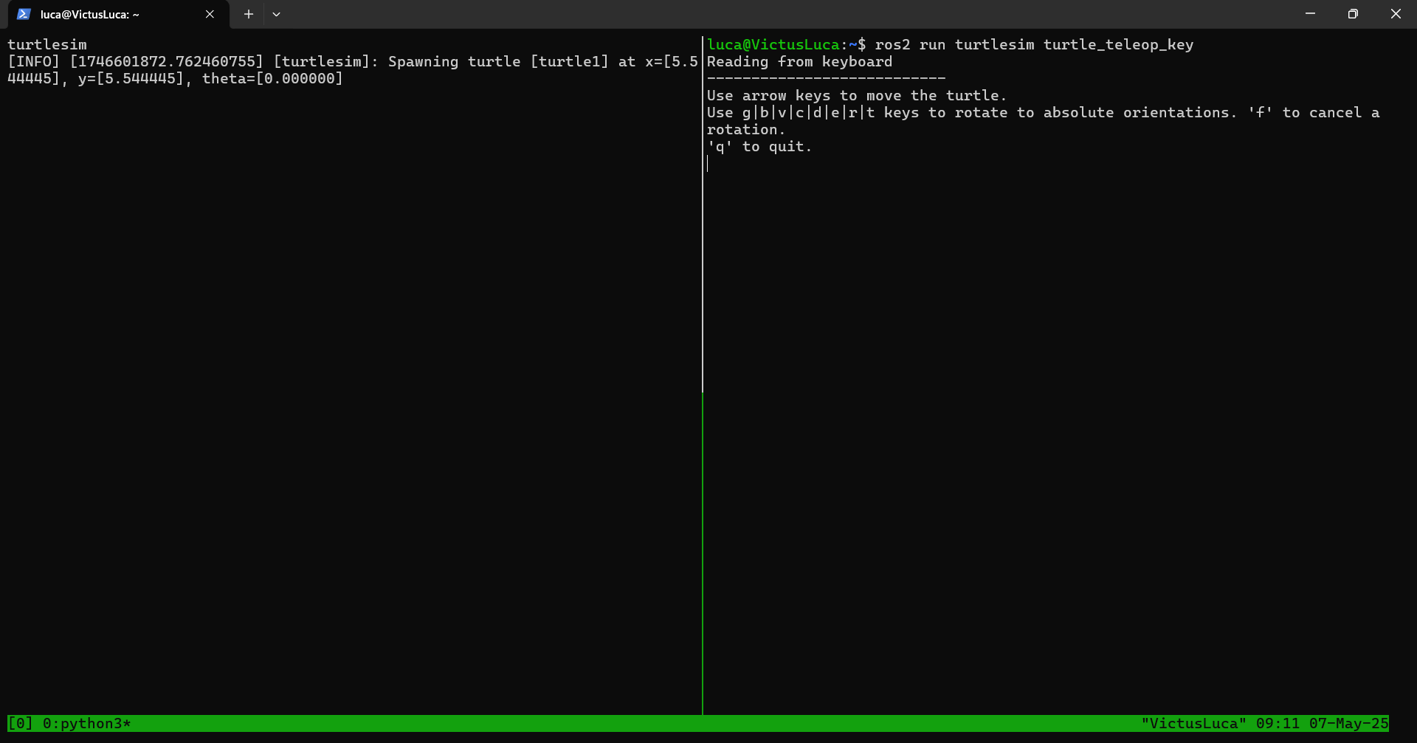
Ex1.1: Turtlebot

Slide 23
Ex1.1: Turtlebot
Why this example?
Imagine the turtle to be a mobile robot: we are controlling it simply with the arrow key. In a real robot it’s a bit more complicated, but it shows the potential of ROS

Slide 24
Ex1.1: Turtlebot (optional)
Further example:
https://docs.ros.org/en/humble/Tutorials/Beginner-CLI-Tools/Introducing-Turtlesim/Introducing-Turtlesim.html
Here you can see an example of a service that spawns a new turtle in the same window

Slide 25
Ex1.2: Simple Node
For the next example, we’re gonna build your first ROS nodes. Let’s first create a new package:
ros2 pkg create --build-type ament_cmake package_prova
If you run the command ls package_prova/
(or simply ls if you’re inside the package_prova folder) you should see:

Slide 26
Ex1.2: Simple Node
Commands to move inside/ outside folders:
To enter: cd <folder_name>
To exit: cd ..
To see what’s inside: ls

Slide 27
Ex1.2: Simple Node
What is a package?
It’s a directory that contains all our code, the libraries we use and all that is needed to implement a specific feature in ROS.
Inside we always have two required files: the CMakeList.txt and the package.xml.

Slide 28
Ex1.2: Simple Node
CMakeList.txt
It contains the «rules» to correctly build our files: it makes sure that every library that we used is present and that the nodes that use them are correctly configured
Package.xml
Contains all the metadata used to define the package itself.

Slide 29
Ex1.2: Simple Node
Then, we usually find various folders. For now, the one we need to know is the src: it contains the codes for our nodes, written either in c++ or python.

Slide 30
Ex1.2: Simple Node
We want to build a simple publisher/subscriber network: one node publishes a message on a topic, the other one receives the message on that topic.
Let’s go inside the src folder (cd src) and create a new file. This will be our publisher:
vi Test_pub.cpp

Slide 31
Ex1.2: Simple Node
For this tutorial we’re using vim to create/modify files directly from the terminal.
Vim is a “screen-based text editor”, a widely used tool in programming.
You could also create a new file in a code editor (i.g. Visual Studio) and then save it inside the src folder, the result is the same. In the next slides we will describe both procedures, use the “standard” one if you’re not comfortable with vim!
Vim cheat sheet: https://vim.rtorr.com/

Slide 32
Ex1.2: Simple Node
Go to: https://github.com/LucaAttorrese/ROS-Workshop/
Open the Test_pub.cpp file and copy the code.
[Vim: Paste the code inside your Test_pub file, then press ESC, then :wq to save]
[Visual studio: Paste the code and save the file]

Slide 33
Ex1.2: Simple Node
Now we can repeat the procedure to create our subscriber
[Vim: vi Test_sub.cpp Copy file from github, press ESC and write :wq]
[Visual studio: Create a new file, copy paste from github and save is as Test_sub.cpp]

Slide 34
Ex1.2: Simple Node
At this point we have our two nodes ready, but it’s not enough to run the program. To do so, we have to modify the other two files that we have in our package: the CMakeList.txt and package.xml.
(On Github you can find the files already completed, under solution/ex1_2. Just copy and paste them and you can avoid the next steps. However, don’t skip them, as we explain what you have to modify each time you create a new package!)

Slide 35
Ex1.2: Simple Node
Let’s modify package.xml:
[Vim: vi package.xml Type “i” to go in INSERT mode]
[Vis. Studio: open the package.xml file]

Slide 36
Ex1.2: Simple Node
We have to add this lines, to make sure that all our nodes can use the specified libraries:
<buildtool_depend>ament_cmake</buildtool_depend>
<depend>rclcpp</depend>
<depend>std_msgs</depend>
[Vim: esc and write :wq]
[V.S.: copy paste and save]

Slide 37
Ex1.2: Simple Node
<buildtool_depend>ament_cmake</buildtool_depend>
Library used fo building the nodes
<depend>rclcpp</depend>
Library of c++ function for ROS2
<depend>std_msgs</depend>
Library that includes standard messages

Slide 38
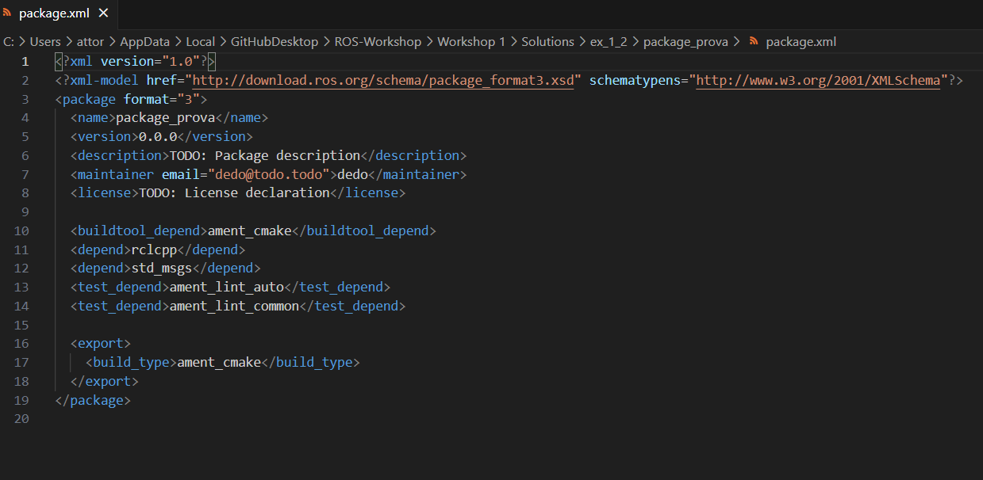
Ex1.2: Simple Node

Slide 39
Ex1.2: Simple Node
Let’s modify CMakeList.txt, by adding the following lines:
find_package(ament_cmake REQUIRED)
find_package(rclcpp REQUIRED)
find_package(std_msgs REQUIRED)
With this lines, we’re making sure that the required packages are installed in our ros environment
The generic syntax of this lines is:
find_package(<library_name> REQUIRED)

Slide 40
Ex1.2: Simple Node
add_executable(Test_pub src/Test_pub.cpp)
add_executable(Test_sub src/Test_sub.cpp)
Here we’re adding all our nodes (“executable programs”), in order to build them. The generic syntax of this lines is:
add_executable(<file_name> src/<file_name>.cpp)

Slide 41
Ex1.2: Simple Node
Then, we need a lines that specify on what libraries the nodes depend on:
ament_target_dependencies(Test_sub rclcpp std_msgs)
ament_target_dependencies(Test_pub rclcpp std_msgs)
The generic syntax is:
ament_target_dependencies(<file_name> <dependency name> <dependency name> …)

Slide 42
Ex1.2: Simple Node
Lastly, for each node:
install(TARGETS
Test_sub
DESTINATION lib/${PROJECT_NAME}/)
install(TARGETS
Test_pub
DESTINATION lib/${PROJECT_NAME}/)
Generic syntax:
install(TARGETS
<file_name>
DESTINATION lib/${PROJECT_NAME})

Slide 43
Ex1.2: Simple Node
Finally, we are ready to launch our first program!
Let’s build the package (out of package_prova folder in tmux!) with the command:
colcon build --packages-select package_prova
If you’re getting errors related to ament_cmake or similar, make sure to have python installed on your pc!
Then source the new package with:
source ./install/setup.bash

Slide 44
Ex1.2: Simple Node
To run the subscriber:
ros2 run package_prova Test_sub
Now open a new terminal (Win/Ub: Ctrl+b then %) to run the publisher:
source ./install/setup.bash
ros2 run package_prova Test_pub

Slide 45
Ex1.2: Simple Node
The syntax to run a node in ros2 is:
ros2 run <package_name> <node_name>
If you go back to the turtlebot example, you may notice that it’s the same command (ros2 run turtlesim turtlesim_node), with turtlesim being the package and turtlesim_node the executable node

Slide 46
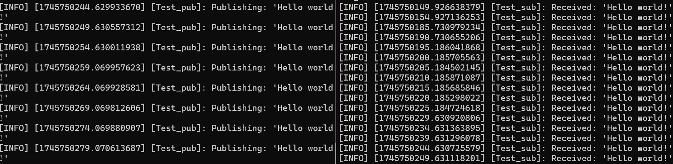
Ex1.2: Simple Node

Slide 47
Ex1.2: Simple Node
That’s great… but how do they work? Let’s analyze the code:
The language is C++: similar to C, but more powerful, as it supports object-oriented programming

Slide 48

Ex1.2: Simple Node
As in C language, the first thing we do is include the libraries we’re using.

Slide 49
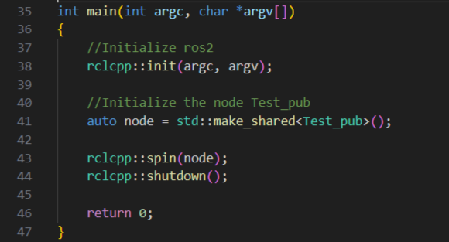
Ex1.2: Simple Node
Let’s start from the main function: the syntax is equal to C.
rclcpp::init is a mandatory line used to initialize ros

Slide 50
Ex1.2: Simple Node
Then, we declare our node with the next line.
The name of the node is the one inside the <>; in this case is Test_pub.

Slide 51
Ex1.2: Simple Node
spin(node): allows our node to runs continously in order to react to events (like sending/receiving a message).
You can see it as a «while(true)» loop.

Slide 52
Ex1.2: Simple Node
shutdown() is necessary to close the node when we kill its execution

Slide 53
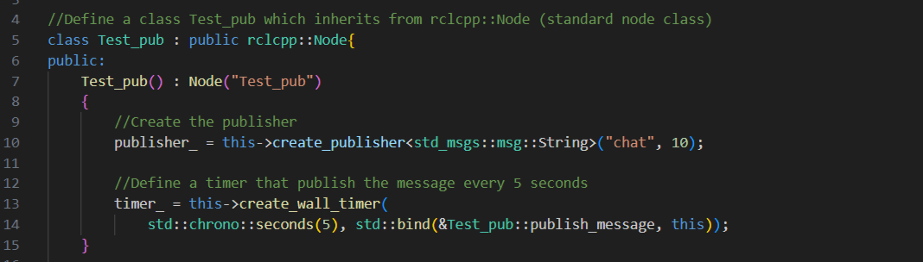
Ex1.2: Simple Node
Now let’s go the fun (?) part: we have to define a class for our node that inherits from the standard ros node class. If what we just said it’s gibberish to you,
don’t worry, we’ll try to explain

Slide 54
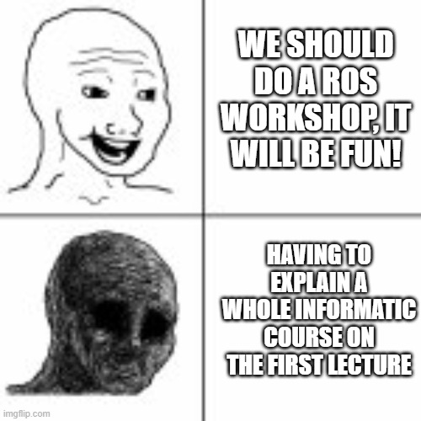
Ex1.2: Simple Node
What is a class?
A blueprint for creating objects that group together data and functions
rclcpp::node is the standard class for ros2 nodes

Slide 55
Ex1.2: Simple Node
In our code, we’re creating a class Test_pub that «inherits» from the standard class.
Inheriting means basically copying the structure of a class, having access in this way to all the function inside it.
So whenever you see a line like rclcpp::<something>, this means that we’re using a function provided by the
standard class for ros2 nodes.

Slide 56
Ex1.2: Simple Node
Inside the class we have two section, public and private. Other programm can access only the methods/function inside the public section.

Slide 57
Ex1.2: Simple Node
Then, we have the publisher creation. The necessary parameters that we have to set are:
Type of message
Topic

Slide 58
Ex1.2: Simple Node
Type of message: in this case it’s a standard message of type String (so, some words)
std_msgs::msg::String

Slide 59
Ex1.2: Simple Node
Topic: the name of the channel in which we want to communicate. In this case it’s «chat»

Slide 60
Ex1.2: Simple Node
There are other parameters that can be inserted, For example in this case, the 10 indicates the size of the publisher queue (how many message can it store if
there are problems in sending them)

Slide 61
Ex1.2: Simple Node
After the publisher, we define a timer. The parameters here are the number of seconds (5), and to which publisher we are attaching the timer to (in this case, it’s publish_message, defined later in the code)

Slide 62
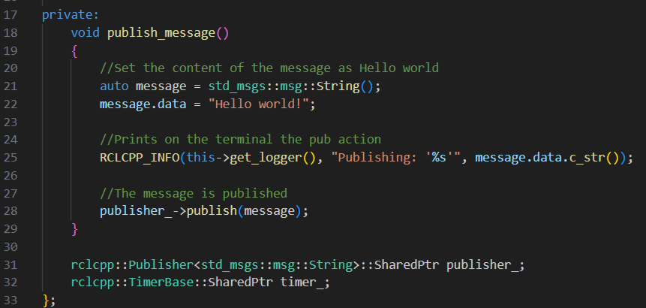
Ex1.2: Simple Node
In the private section, we define the function publish_message. Inside it, we declare a message variable in which we will store our string.

Slide 63
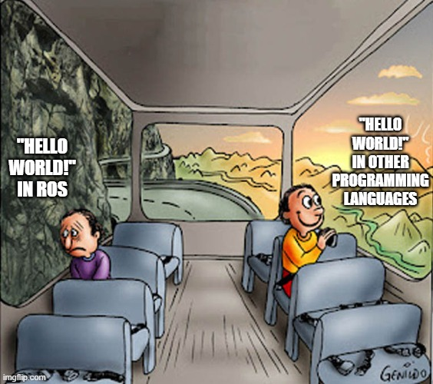
Ex1.2: Simple Node
To insert the string, we set the field data to «Hello world!»

Slide 64
Ex1.2: Simple Node
Then, we insert a print to see the message we are publishing on our terminal.
Lastly, we actually publish the message with publisher_->publish(message)

Slide 65
Ex1.2: Simple Node
The last two lines are the function declaration for both the publisher and the timer.

Slide 66
Ex1.2: Simple Node
The last two lines are the function declaration for both the publisher and the timer.

Slide 67
Ex1.2: Simple Node
For the subscriber, the structure is the same, with the difference that we declare a subscriber function and we don’t have a timer (ther’s no need for it as we want to receive each message published). The important thing is that the topic of publisher and subscriber coincide!

Slide 68
Ex1.3: Launch file
We can avoid launching the nodes one at a time by using a launch file: basically a python scripts that launches multiple nodes together.
Create a launch folder in ./package_prova:
[Vim: cd package_prova && mkdir launch && cd launch]
[V.S.: create a new folder called launch]

Slide 69
Ex1.3: Launch file
Create and copy the launch file:
[Vim: vi test_launch.launch.py
Then copy the file from Github, from solutions/ex1_3/launch with the same procedure as before]
[V.S: create a file called test_launch.launch.py, copy, paste from Github and save]
We need to add this line into the CMakeList.txt
install(DIRECTORY launch DESTINATION share/${PROJECT_NAME}/)

Slide 70
Ex1.3: Launch file
Let’s build the package (out of package_prova folder in tmux!):
colcon build --packages-select package_prova
source ./install/setup.bash
To run the launch file:
ros2 launch package_prova test_launch.launch.py

Slide 71
Thank you!
We hope to see you on 12th May in B15 LM4 to complete the previous session’s exercises and discover the world of localization.

